Slide 1
Time Series

Slide 2
Time series forecasting is a critical requirement for many organizations.
The starting point of forecasting is a time series visualization, which provides the flexibility to reflect on historical data and analyze trends and seasonal components.
It also helps to compare multiple dimensions over time, spot trends, and identify seasonal patterns in the data.
Examples: stock market analysis, population trend analysis using a census, or sales and profit trends over time.

Slide 3
Definition of Time Series
Time series analysis is a statistical technique used to record and analyze data points over a period of time, such as daily, monthly, yearly, etc.
A time series chart is the graphical representation of the time series data across the interval period.

Slide 4
Steps
The built-in date and time functions allow you to use the drag-and-drop option to create and analyze time trends, drill down with a click, and easily perform trend analysis comparisons.

Slide 5
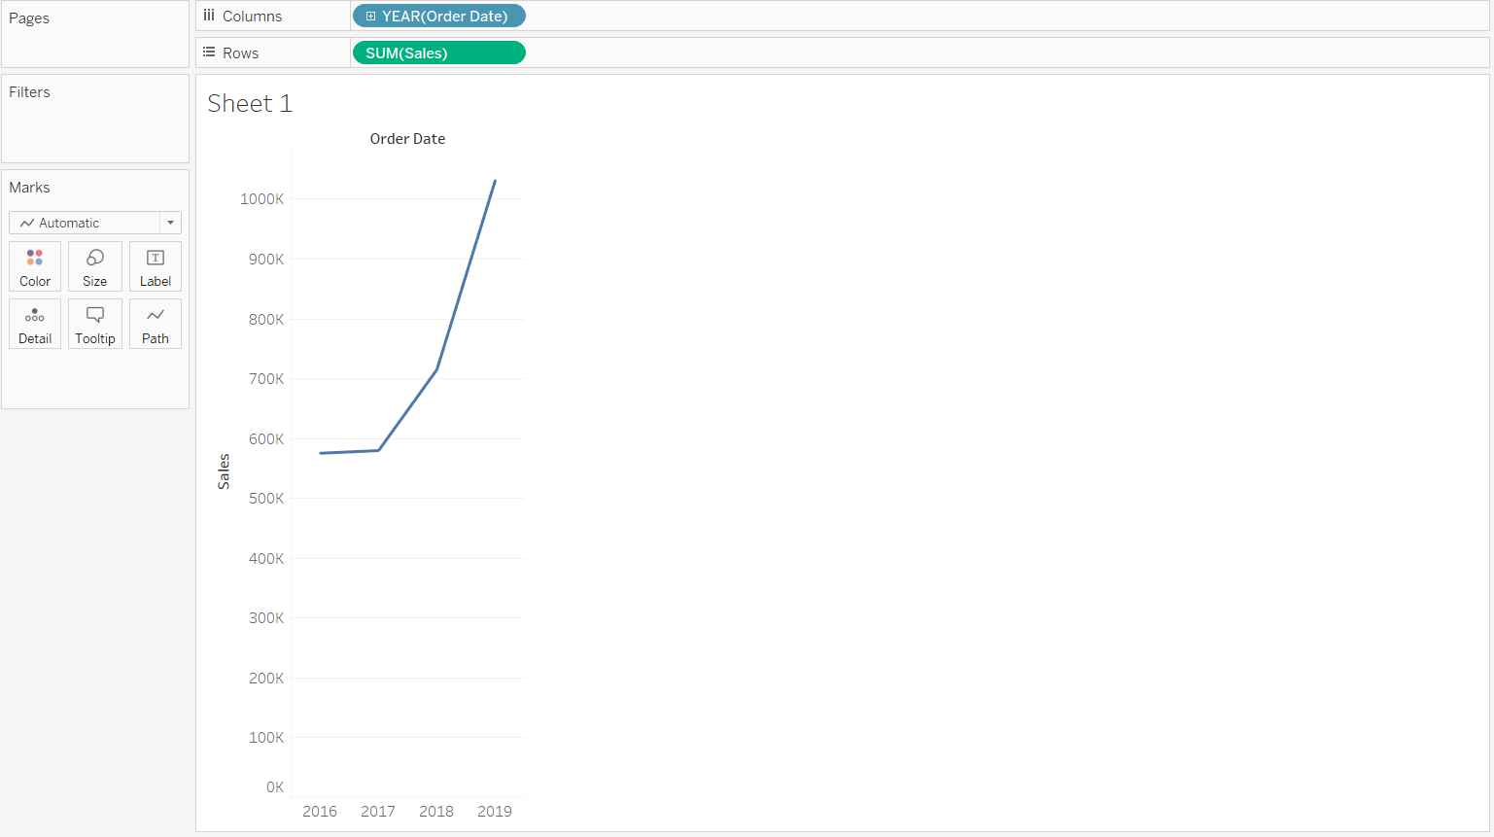
Drag the Order Date field to the Columns shelf and the Sales variable to the Rows shelf. The default chart will give us a yearly trend line chart. The Marks shelf automatically selects a line graph for the chart.

Slide 6
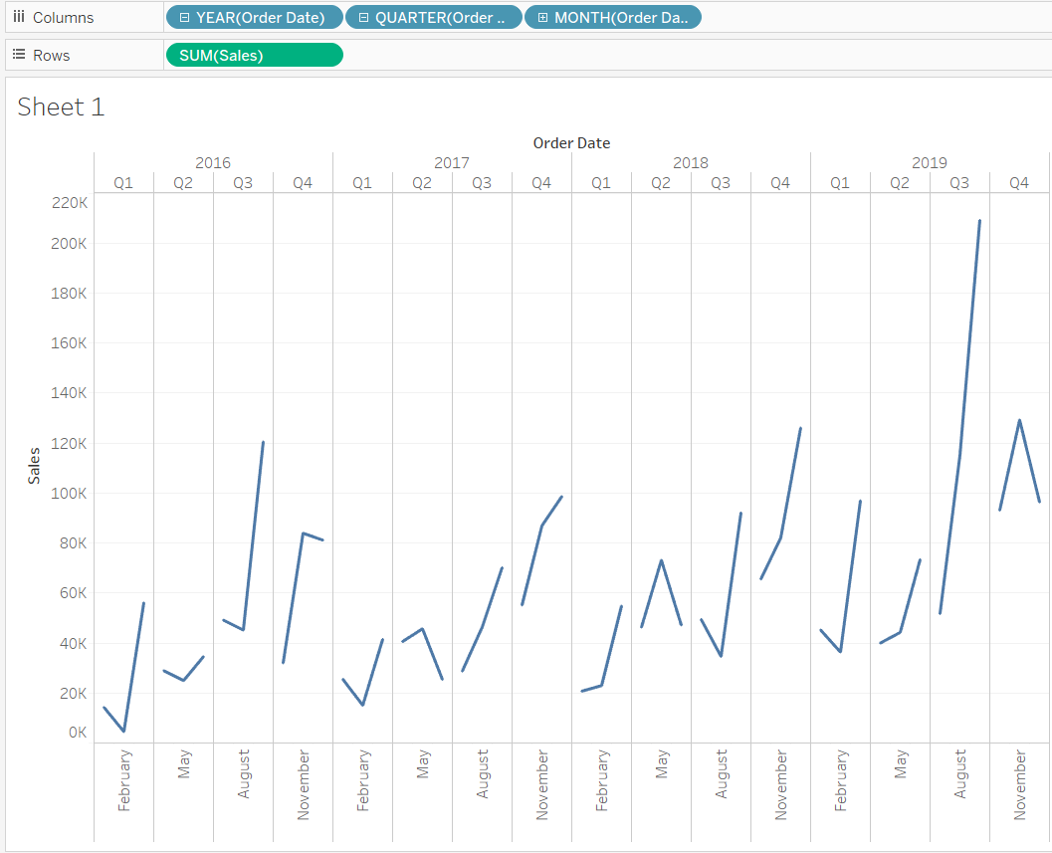
In the chart above, we see that the display is in years. To further drill down to quarter and month levels, we can simply click on the plus icon on the order date in the Columns shelf. This will generate the following output, which now displays the data broken down to the month and quarter level.

Slide 7
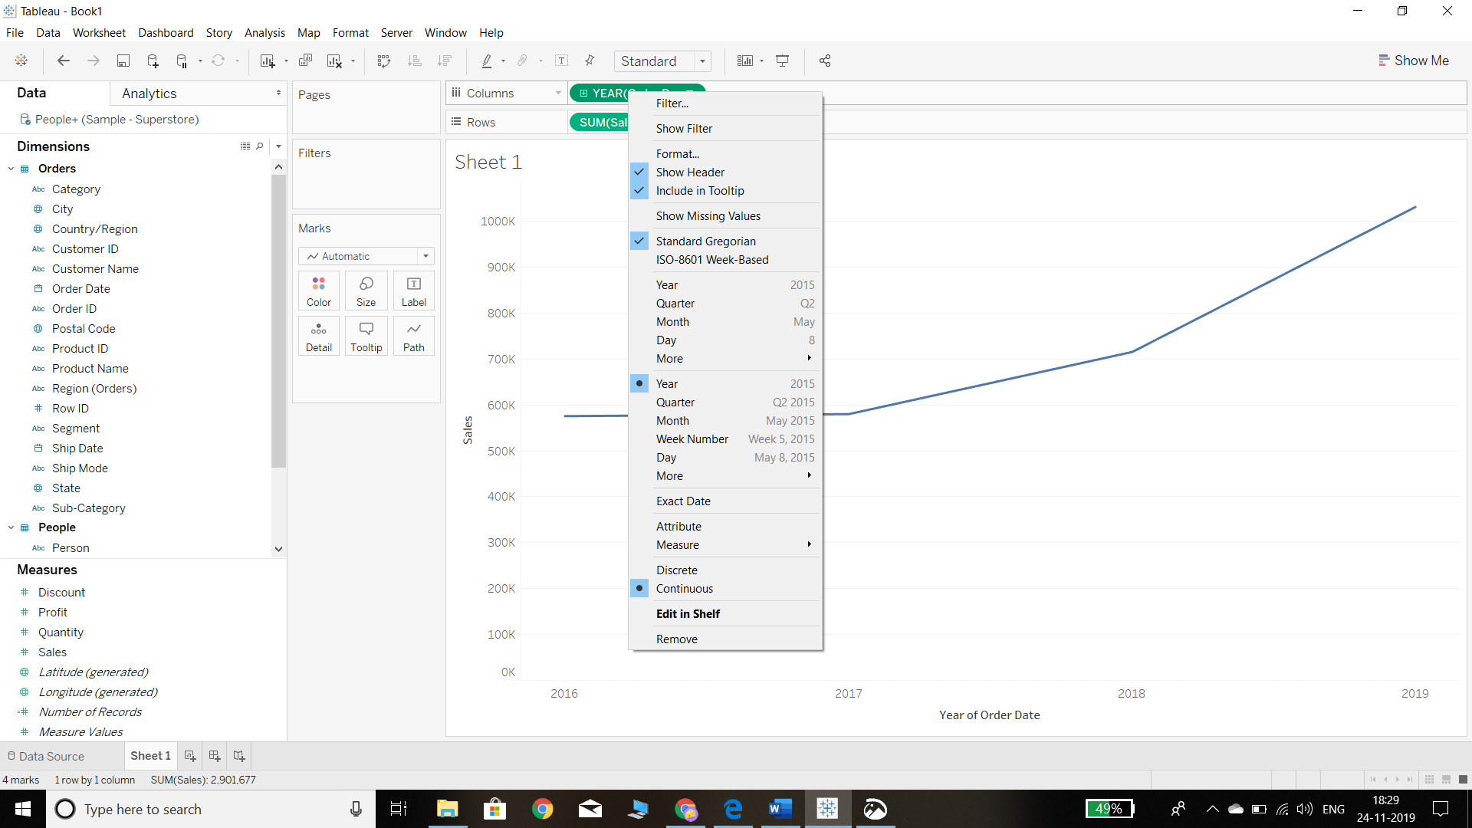
The above chart is useful, but it is displayed in a discrete format. It will be more beneficial if the data is displayed in continuous form. To convert the chart into a continuous format time series chart, the first step is to roll up the YEAR (Order Date) back to year level, and then the second step is to right-click on it and select the Year and Continuous options. This is illustrated in the chart below.

Slide 8
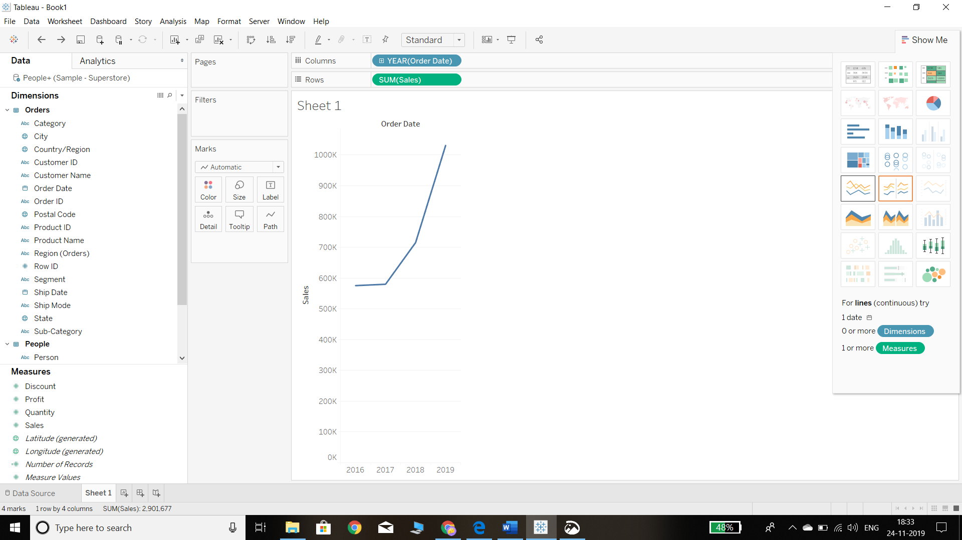
Another option in Tableau to build the continuous chart is to directly select the line chart type in the Show Me card, as shown in the chart below.
The above chart shows the trend of annual sales during the period 2016 through 2019. There is a continuous trend of increase in sales volume. However, it is better to analyze the time series data by breaking it down to a monthly level.

Slide 9
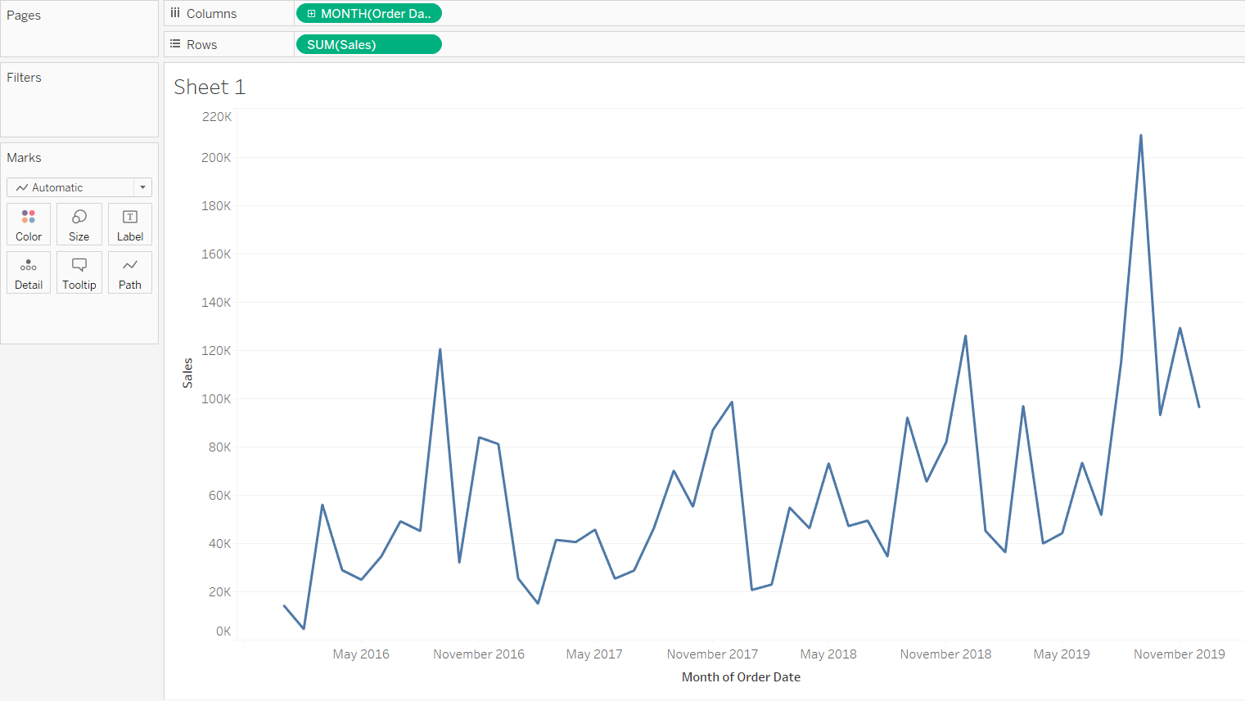
It is easy to change the chart breakdown from annual to monthly. This can be done by simply changing the Columns shelf from YEAR (Order Date) to MONTH (Order Date). This will generate a monthly time series chart. From an analytics perspective, this chart is more insightful as it allows us to see the sales fluctuations across months and years. This is also useful for decomposing the seasonality and trend components of the time series data.

Slide 10
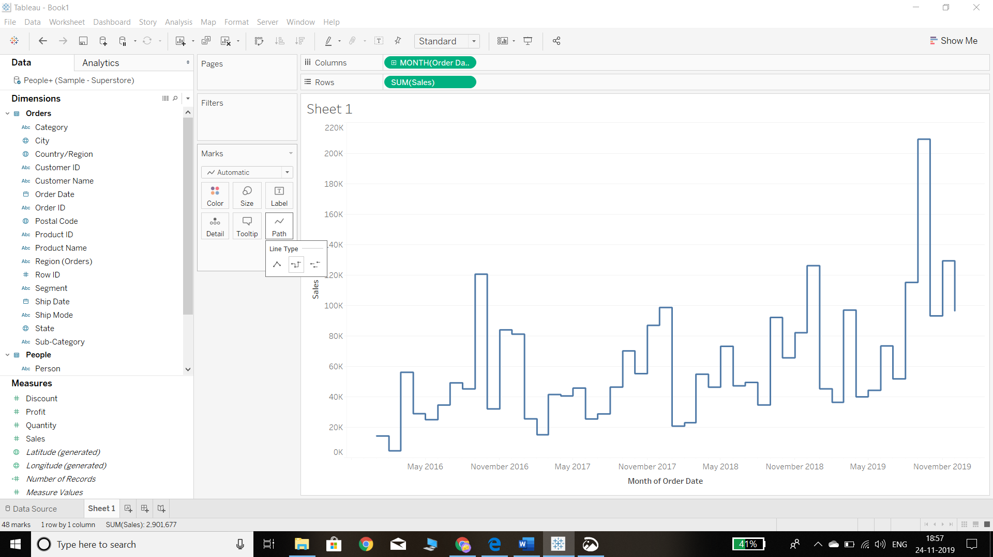
Tableau also provides the ability to change the path property as well as the chart type.
Change the Path Property
We can change the path property by going into the Marks shelf and clicking on the Path option. There are three options for the type of line graph for the view, and selecting the second option will produce the following chart. The output is like the previous chart, but the trend shifts are more pronounced now.

Slide 11
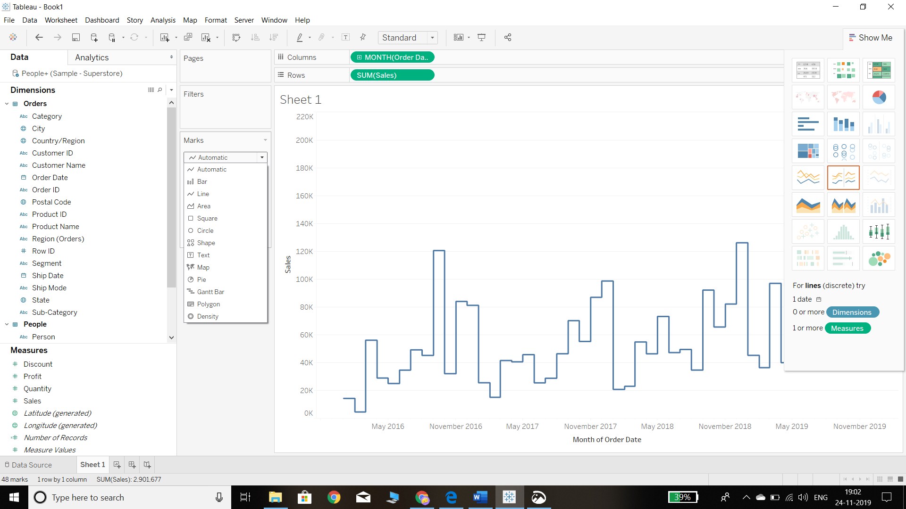
Change the Chart Type We can change the chart type to options such as a bar or an area chart, either from the Marks shelf or from the Show Me option. However, for time series data, this is not suggested as the line chart is the best option.

Slide 12
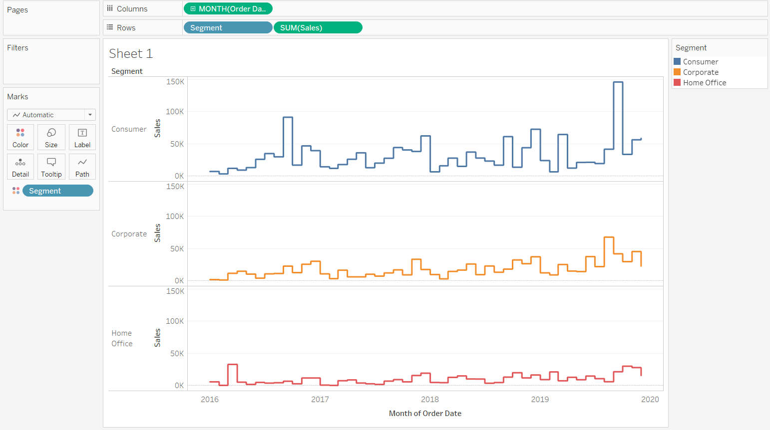
Adding Categories to Time Series
to add more variables to a chart to understand and analyze it better. For instance, it could be useful to visualize sales by segment across time. This can be done easily in two ways. First, simply drag the Segment field to the Color pane in the Marks shelf. The second method is to move the category to the Rows shelf to show it separately.

Slide 13
Models of Time Series Analysis

Slide 14
Additive Model
Additive model analysis is a newly emerged approach for time-series modeling.
Unlike traditional approaches(like ARIMA and exponential smoothing) that explore time-based dependencies among observations, it treats time-series modeling as a curve-fitting problem, and uses an additive model to fit/forecast time-series data.

Slide 15
Under this setting, the given time-series would be decomposed into four components: trend, seasonality, cyclic patterns, and a random component.
The formula is as follows:
𝑦(𝑡)=𝑔(𝑡)+𝑠(𝑡)+ℎ(𝑡)+ϵ(𝑡).

Slide 16
It can handle data with complicated trend(using piecewise linear approximation), multiple seasonality(daily, weekly, yearly and beyond, event if period being non-integer) with strong seasonal effects.
Besides, the modeling of cyclic patterns also helps to explain variations with non-fixing period.
As a consequence, additive model time-series analysis often has better performance when comparing with other classical methods for time-series modeling/analysis.

Slide 17
Time series is statistical data that we arrange and present in a chronological order spreading over a period of time.
Time series analysis is a statistical technique dealing with time series data.
According to Spiegel, “A time series is a set of observations taken at specified times, usually at equal intervals.”
In statistics, for time series analysis two main categories of models are popular.

Slide 18
Models of Time Series Analysis
In time series quantitative data are arranged in the order of their occurrence and resulting statistical series.
The quantitative values are usually recorded over equal time intervals such as daily, weekly, monthly, quarterly, half-yearly, yearly, or any other measure of time.
Examples
statistics of Industrial Production in India on a monthly basis, birth-rate figures annually, the yield on ordinary shares, and weekly wholesale price of rice, etc.

Slide 19
Components of Time Series
There is a different kind of forces which influence the time series analysis.
Some are continuously effective while others make themselves felt at recurring time intervals.
A time series consists of the following four components or basic elements:
Basic or Secular or Long-time trend;
Seasonal variations;
Business cycles or cyclical movement; and
Erratic or Irregular fluctuations.

Slide 20
A time series consists of the following four components or basic elements:
Basic or Secular or Long-time trend;
Seasonal variations;
Business cycles or cyclical movement; and
Erratic or Irregular fluctuations.
Notes:
These components provide a basis for the explanation of the behavior on the past time. With their help, one can predict the behavior ahead. The major tendency of each component or constituent is largely due to causal factors.

Slide 21
Mathematical Statements of Time Series
Some time series may not be affected by all type of variations. Some of these types of variations may affect a few time series only. Hence, while analyzing the time series, these effects are isolated.
In a traditional time series analysis, we assume that any given observation consists of the trend, seasonal, cyclical and irregular movements.

Slide 22
Models of Time Series Analysis
(1) Additive model, and
(2) Multiplicative model

Slide 23
1) Additive Model
In the additive model, we represent a particular observation in a time series as the sum of these four components.
i.e. O = T + S + C + I
where O represents the original data, T represents the trend. S represents the seasonal variations, C represents the cyclical variations and I represents the irregular variations.
In another way, we can write Y(t) = T(t) + S(t) +C(t) + I(t)

Slide 24
2) Multiplicative Model
In this model, four components have a multiplicative relationship. So, we represent a particular observation in a time series as the product of these four components:
i.e. O = T × S × C × I
where O, T, S, C and I represents the terms as in additive model.
In another way, we can write Y(t) = T(t) × S(t) × C(t) × I(t)

Slide 25
This model is the most used model in the decomposition of time series. To remove any doubt between the two models, it should be made clear that in Multiplicative model S, C, and I are indices expressed as decimal percentages whereas, in Additive model S, C and I are quantitative deviations about a trend that can be expressed as seasonal, cyclical and irregular in nature.

Slide 26
Example:
If in a multiplicative model.
T = 500, S = 1.4, C = 1.20 and I = 0.7
then O=T × S × C × I
By substituting the values we get
O = 500 × 1.4 × 1.20 × 0.7 = 588
If in additive model,
T = 500, S = 100, C = 25, I = –60
then O = 500 + 100 + 25 – 60 = 565

Slide 27
Which model is more appropriate for time series analysis?
The assumption for the two schemes of analysis is that whereas there is no interaction among the different constituents or components under the additive scheme, such interaction is very much present in the multiplicative scheme. They do not depend on the level of the trend. With higher trends, these variations are more intensive. Though in practice the multiplicative model is the more popular, both models have their own merits. Depending on the nature of the time series analysis, they are equally acceptable.

Slide 28
Note
Additive model:
If there is not trend the additive model can be used
Multiplicative model:
If there is trend the Multiplicative model can be used

